Slide 1


Slide 2
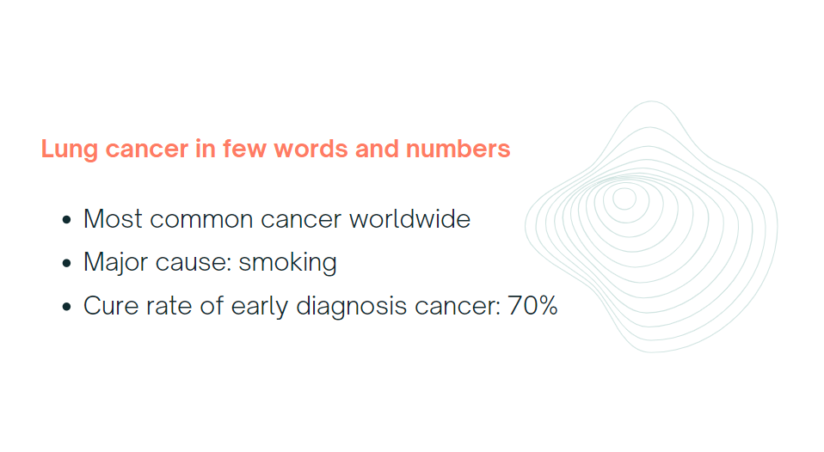

Slide 3
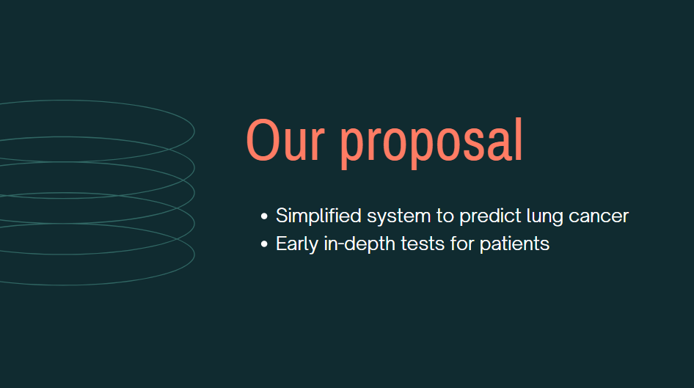

Slide 4
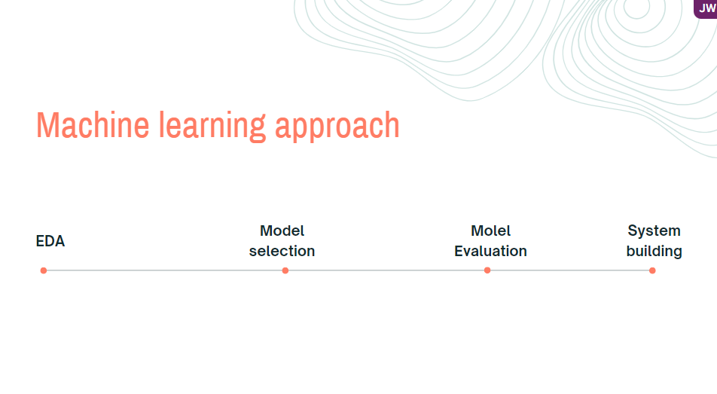

Slide 5

EDA

Slide 6




Classification Step
Lung Cancer?
Yes
No
Small or Non-Small?
Normal
Non-small
Small

Slide 7
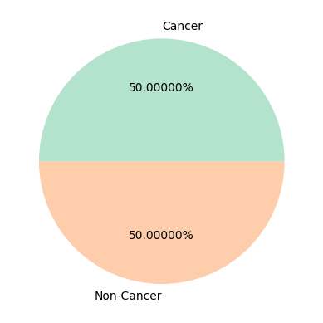
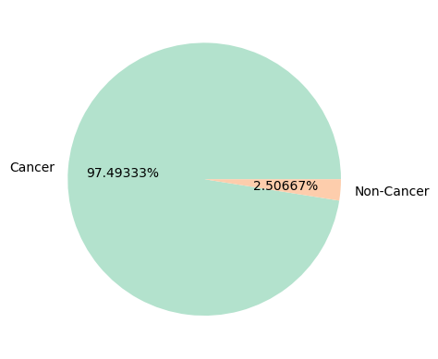
Preprocessing; SMOTE

Slide 8
Classification: whether cancer or not

Slide 9
Prediction: Whether small cell cancer, or not

Slide 10
Feature Importances

Slide 11
Expected Life Time

Slide 12
CONCLUSION

